Slide 1
2-Way Out Of Order Processor
By Douglas Smith and Casey Gooch

Slide 2
What is Out Of Order(OOO) Execution
OOO execution is when the processor is able to execute the input instructions in a different order then the specified program order
Instructions are still fetched in order and completed in order(more on this later), but the order in which the functionality of the instruction occurs can change

Slide 3
How OOO works/why it is useful
OOO runs on instruction level parallelism (ILP)
Consider this code (left two inputs, rightmost output)
MULT X1, X2, X3
SUB X3, X4, X5
ADD X6, X6, X7
SUBI X8, X9, X6
SUB is dependant on MULT but ADD and SUBI are not, these can start running while we wait for MULT to complete
OOO lets you skip around other long commands as well such as DIV and memory accesses

Slide 4
What prevents OOO
Hazards read after write (RAW), write after read(WAR), and write after write(WAW)
MULT X1, X2, X3
SUB X3, X4, X5
ADD X6, X6, X7
SUBI X8, X9, X6
ADD X5, X6, X7
However the only real dependencies are the RAW hazards, the WAR and WAW are “fake” dependencies and can be dealt with using register renaming

Slide 5
Implementing OOO (Important Units)
The major units needed for OOO are as follows:
Re-Order Buffer:
  Saves important information about instructions as they come in (the register it is writing too, the type of instruction)
  Preserves the order instructions come in, with the oldest at the head and the newest at the tail
  Save values as they leave the execution stage
Map table
  Stores a tag that tells where the most current value of a register is currently located
Reservation Station
  Stores the values and tags of an instruction and holds it until all the values needed for that instruction have been acquired
Load Store Queue

Slide 6
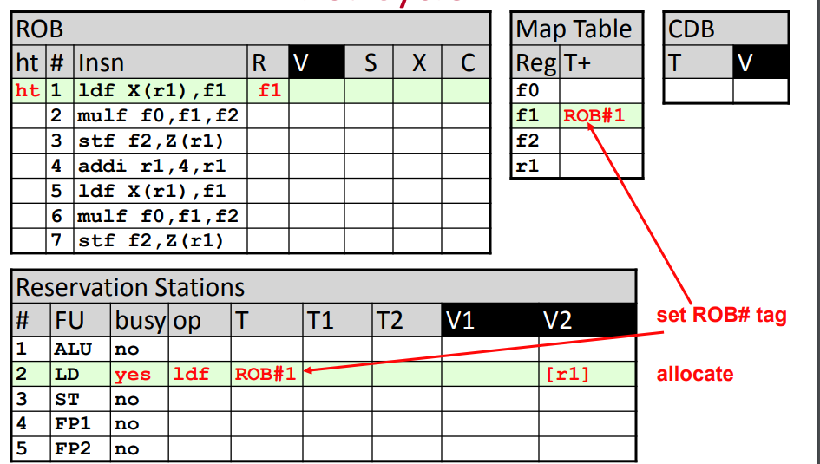
Register Renaming in OOO (1)
The map table, the ROB, and the RS all work together to correctly handle register renaming

Slide 7
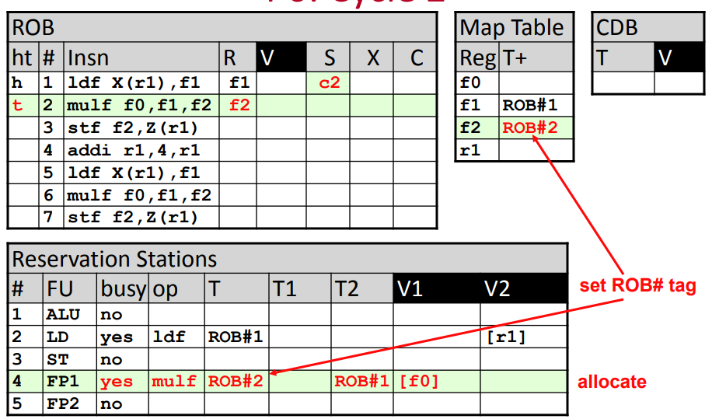
Register Renaming in OOO (2)

Slide 8
Register Renaming in OOO (3)
Each dependency is handled
RAW: Instructions can’t move forward until all their values are loaded into the RS
WAR: Read locations are preserved in the RS even after the map table value has been written over
WAW: The write location is separated into two different locations in the ROB, breaking the dependency

Slide 9
OOO stages
In our original 5 stage pipeline we had an instruction fetch stage, decode stage, execution stage, memory stage, and write back stage
For OOO we need a new set of stages
  IF: Same
  Decode: Now needs to manage MT, ROB, and RS
  Issue: Flow from RS to execution units
  Execution: Largely the same
  Memory: Loads are the same, stores don’t occur here
  Completion: Write back to the ROB and RS
  Commit: Write to RF, mem, and flags when the instructions at the head of the ROB is ready

Slide 10
Issues with the system
There are two major areas that cause problems in OOO
Branching:
  At branch time, we don’t know which way to go
  Have to make a guess (branch prediction), could be wrong
  The system has the wrong commands flowing through it
Storing:
  All of memory is a read/write hazard to itself
  If our instructions are in this order, STUR(#8), LDUR(#10), LDUR(#8) and the second load is executed before the store, our behavior is incorrect

Slide 11
Big fix
The big fix to solve these issues is in the commit stage
Instructions are committed in program order, so the effect of an instruction isn’t seen in any “permanent” memory until we are sure that the behavior is correct
If behavior was incorrect the ROB, RS, and MT are all reset, clearing out the incorrect behavior
When an instruction is at the head of the ROB and is ready to commit
  For LOADs and basic math functions when their data arrives they can go straight to memory, they are safe
  For branches we check if the branch was correct, if it wasn’t wipe and set the PC to the correct jump point
  For stores checking is a little more complex

Slide 12
Load Store Queue

Slide 13
Upgrading to 2-way
While OOO behavior can improve the perform, it can never get lower then 1 instruction per cycle
For that you need to go to 2-way issue(issue two instruction per cycle)
Bring in complications
  Number of execution units/RS needs to double
  Need to check between the 2 instructions for any hazards
  If the first instruction is a branch, may need to toss the second instruction
  Etc

Slide 14
Timeline
Week 4: Upgrade baseline 5-stage pipeline, expand the command list, add a multiplier, divider, and shifter
Week 5: Wrap up multiplier and divider, begin work on OOO units
Week 6: Push the system through the tools, continue work on OOO
Week 7: Finish OOO
Week 8: Work on 2-way issue upgrade
Week 9: Finish 2-way issue upgrade

